Slide 1
Report to the Legislature
Financial Addendum
June 9, 2021

Slide 2
Table of Contents
Introduction
  Key Takeaways
  A&F Roadmap 3.5
  Enrollment, Admissions & Occupancy
FY22 Budget Overview
Appendices
  FY22 Tuition & Mandatory Fees
  Ratios
  FY22 Revenue & Expense Details
  FY23-27 Preliminary Forecast Trends
  Campus Details

Slide 3
Key Takeaways
Campuses returning to normal academic & student life activities; campus housing is open
Staffing levels growing consistent with campuses being open
Applications are up, expecting enrollment to be stable
  Uncertainty remains but real-time monitoring will continue
Federal stimulus funds are critical and allow the University to avoid deficits
Absent federal stimulus the University has a structural gap
Long term financial planning is required
  Financial forecast delivered in December to demonstrate structural balance and a return to positive operating margins
Accountability framework guides our approach to long term financial sustainability

Slide 4









UMass Framework for Financial Accountability
Independent & objective assurance that analyzes data, processes, policies & controls
Standard processes to provide reasonable assurance regarding achievement of objectives
Goal 1: Ensure financial sustainability & mitigate risk
Goal 2: Deliver efficient operations to ensure access and
affordability for students
Goal 3: Improve our capacity to deliver financial,
administrative & other service objectives to
our customers
Financial Sustainability
Capital
Strategy
Risk
Management
Tax
Compliance
ACCOUNTABILITY
OVERSIGHT
INTERNAL
CONTROLS
Shared Services
Operations
RISK
MANAGEMENT
TRANSPARENCY
Analysis
Human
Resources
Financial
Reporting
Reliable, timely information that is accessible & understandable
Systematic approach to identifying, assessing & managing risks across the organization

Slide 5


A&F Roadmap 3.5
Progress Underway
Upcoming Intersections
Coordination of University's COVID Response
  Nearly 685,000 tests conducted - positivity rate of 0.49%
Advisory Working Group on Financial Planning
Strengthen University budget/forecasting
UPST Implementation
  Proactive sourcing opportunities
  More analytics and better cycle times
  $29.9 million in cost savings
Restructure cash management plan
  Executed line of credit in May
Analyze financial aid data and trends
Design future of work for UMPO
Enhance University-wide ERM Program
  Update assessment tools and risk mitigation methodology
  Coordinate efforts to develop consistency in travel authorization
Streamline procurement contracts and optimize procurement processes
Implement phase 1 of payroll shared services
Improve production of valuable financial reporting
Implement standard for lease accounting (GASB 87)
Implement additional UMPO diversity, equity & inclusion initiatives

Slide 6
Enrollment, Admissions & Occupancy

Slide 7
Change in Student Behavior Post-COVID
Historical trends may no longer be accurate predictors of student behavior.
Retention of existing students: to date registrations tracking to budget assumptions
New students: to date tracking to budget assumptions:
  New freshmen: assessing impacts of a declining high school population
  Transfers: Community college enrollment effect on transfers; 31.2% decline since 2009; average decline of 3.3% a year
Carefully monitoring:
  Changes in student residency mix
  International
  Demand for on campus housing
Key Dates:
April 5th: Registration Opens (returning students)
May 1st: Deposit Deadline
June-August: Orientations for New Freshman
Classes Begin:
  September 1st: Amherst, Dartmouth, Lowell
  September 7th: Boston
September 15th: Add/drop ends

Slide 8

FY22 Fall Enrollment Assumptions (as of 6/7/21)
5-year average growth rate of 0.9%; 10-year average growth rate of 1.7%;
Total Enrollment (FTE):
65,609 FTEs 0.7%
Undergraduate New:
469 or 3.4%
Undergraduate Continuing:
5 or 0.0%
(1) During this period, due to COVID, groups of students were electronically enrolled resulting in higher FY21 YTD.

Slide 9
FY22 Fall Admissions Tracking (as of 6/7/21)
New freshmen acceptances & deposits are below compared to same time last year; Transfers above.
New (Freshmen):
Deposits (headcount)
816 or 7%
New (Transfers):
Deposits (headcount)
367 or 14%
Source: Fall admissions tracking from A&F Dashboard & Amherst campus;
(1) Prior year actual enrollment from Student Profile

Slide 10
Housing Occupancy Assumptions
Campuses are open, occupancy budgeted near normal and being monitored.

Slide 11
Select Sensitivity Analysis for FY22
Assumptions made for enrollment and housing occupancy vary by campus
Real time tracking of deposits for new students, registrations for continuing students and commitments for housing underway
Revenue impact of +/- each 100 student FTEs:

Slide 12
FY22 Budget Overview

Slide 13
FY22: Quarterly Reporting
Board Meeting: September 15th
Initial reporting on enrollment
Classes Begin(planned on-campus):
  Amherst, Dartmouth, Lowell: September 1st
  Boston: September 7th
Add/Drop Ends: by September 15th
Board Meeting: March/April 2022
Begin tracking Fall 22 (FY23) admission data
Spring Classes Begin:
  Amherst, Boston: January 25th
  Lowell, Dartmouth: January 18th
Q2 Report completed: February 2022
July-Sept.
Oct. – Dec.
Jan. - March
Apr. – Jun.
Board Meeting: December 15th
Refresh five-year Forecast
Q1 Report completed: November 2021; Impact of Fall enrollment & management of FY22
Board Meeting: June 2022
Tracking enrollment & admissions for Fall 2022
FY23 budget development & scenario planning
Q3 Report completed: May 2022

Slide 14
FY22 Budget: Assumptions

Slide 15
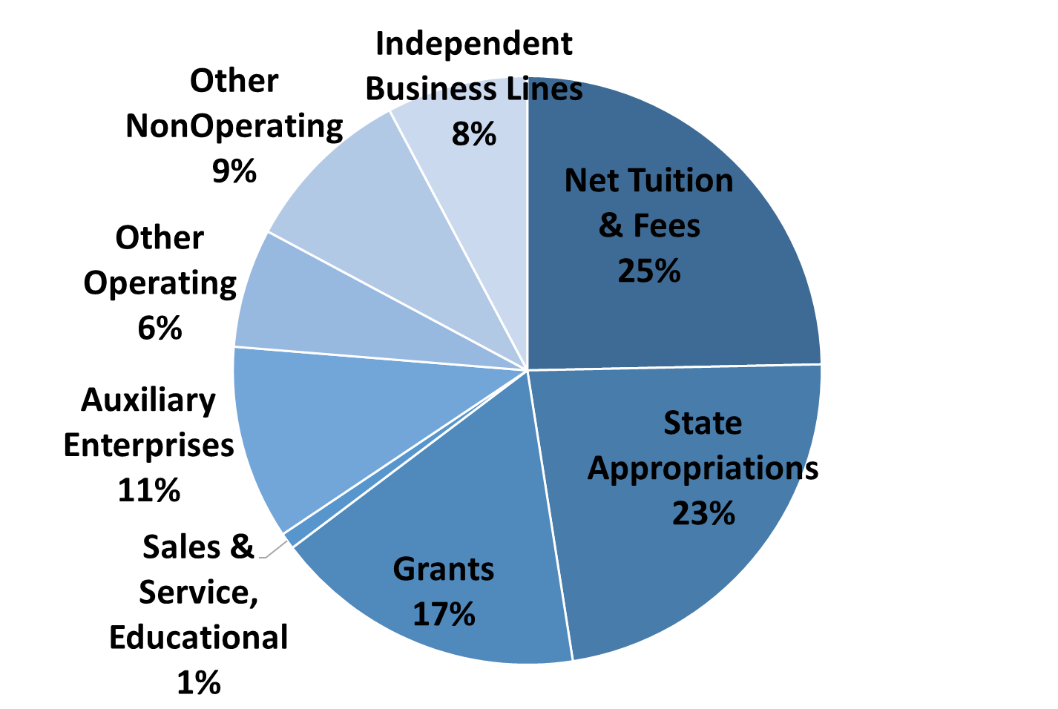
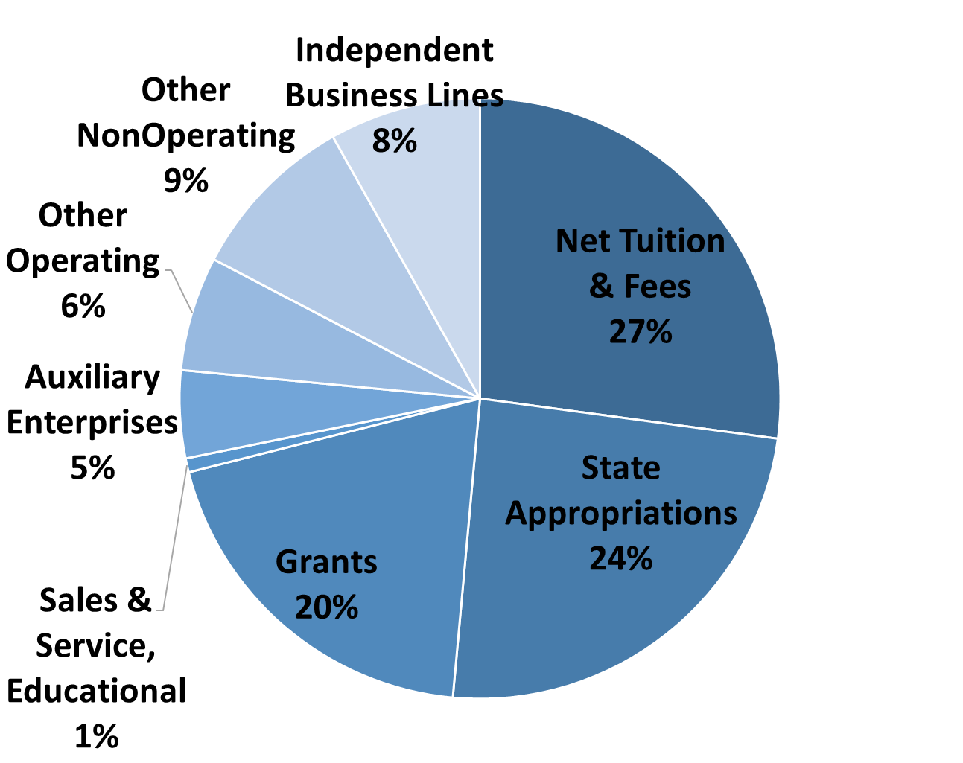
University Revenue Sources
FY22 Total Revenue = $3.7B
FY21 Total Revenue = $3.4B

Slide 16
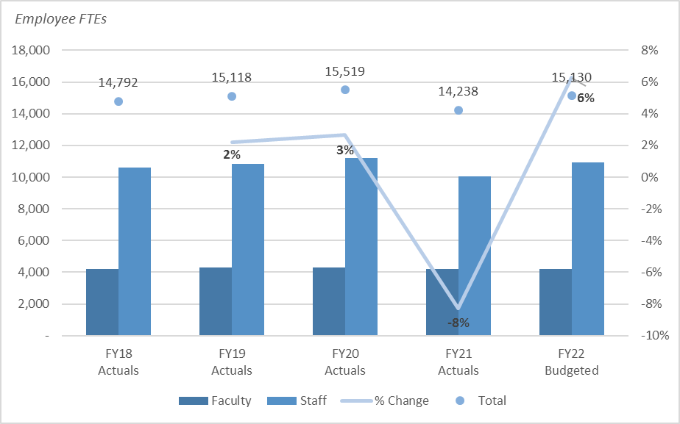
University Staffing
FY22 budgeted staffing levels are consistent with campus operating plans.
*Actuals as of 9/30 each year

Slide 17
Combined Operating Margin (FY21 + FY22):
Without Stimulus
*Does not include impacts of GASB 68 & 75

Slide 18
University: Revenue & Expenses
Increasing
Note: Total revenue includes unrealized gains/losses that are excluded from the operating margin calculation; total expenses excludes the impact of GASB 68&75 consistent with the operating margin calculation

Slide 19
Federal Stimulus Overview
Student Aid:
$113.5M across multiple rounds
Emergency grants to students
  Prioritize “exceptional need”; includes but not restricted to students receiving Pell grants
  Not conditioned on continued enrollment
  Can satisfy outstanding balances with consent
  Not considered financial aid or taxable income
Institutional Allocation:
$145M across multiple rounds
Recovers a portion of lost revenue due to the pandemic
Bridge to a post-COVID environment including but not limited to:
  One-time operating and/or infrastructure investments
  Strategic investments that grow revenue (enrollment and retention; programmatic and research)

Slide 20
Student Emergency Aid Grants
University students will directly receive $113.5 million of emergency aid.
Grants to students:
Campuses have provided emergency grants:
  FY20 = $14.7 million
  FY21 = $30.1 million
All campuses plan to provide the remaining $68.8 million in FY22
Understanding revenue and expense impacts:
Student grant revenue and expense are recognized in the year which they are provided to students; no operating margin impact
Awarding student grants trigger recognizing institutional revenue regardless of when the funds are spent; skewing operating margin
*Based on best estimates included in FY22 plan; actuals may vary

Slide 21
Institutional Stimulus Aid
Revenue must be recognized as student aid is distributed, skewing campus operating margins
CARES, HEERF II & III Institutional Awards:
FY20 – revenue recognized to cover actual COVID related costs
FY21 & FY22 – revenue recognized based on use of student funds
Understanding revenue and expense impacts:
Institutional Aid revenue must be recognized when (in the year) student aid is distributed
Revenue will increase regardless of when the institutional funds are spent; skewing operating margin
Individually, FY21& 22 operating margins are skewed; must look at a 2-year operating margin view
Funds will be spent over multiple years as some will be used for capital investments
*Based on best estimates included in FY22 plan; actuals may vary

Slide 22
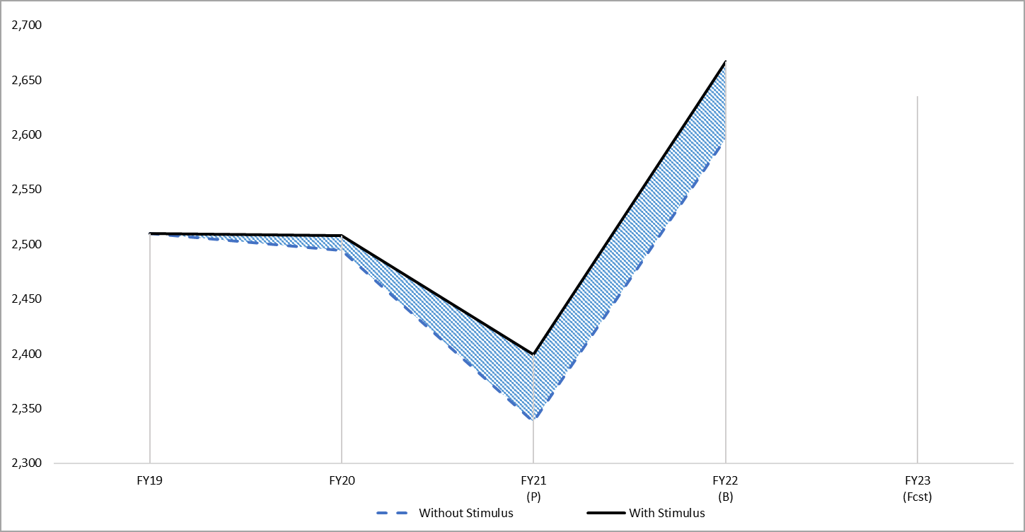
Stimulus Helps Bridge Undergraduate Revenue Loss
“Normal” campus operations FY22-23
11%
4%
10%
Stimulus used as a bridge while campus operations transition back to ‘normal’
Increased housing occupancy and stable enrollment trends will drive revenue growth
0%
0%
-4%
$230M housing & dining impact
-8%
(1)
(1,2)
(1) Total revenue for Amherst, Boston, Dartmouth, Lowell; excludes Medical School & President’s Office
(2) Includes CARES, HEERF II & HEERF III; Assumes near pre-COVID occupancy in fall FY22; normal thereafter

Slide 23
Combined Operating Margin (FY21 + FY22)
FY21 Projection: includes $91.6 million stimulus ($30.1 million student, $61.5 million institutional)
FY22 Budget: includes $138.4 million stimulus ($68.8 million student, $69.6 million institutional)
*Does not include impacts of GASB 68 & 75; Federal stimulus funds recognized in FY21 will be available for campus use in FY22

Slide 24
Key Takeaways
Enrollment is stable, return to normal academic & student life activities & campus housing is open; there is uncertainty but real-time monitoring will continue (65,609 FTEs; -0.7%)
Staffing levels growing consistent with campuses being open (15,130 FTEs; +6%)
Federal stimulus funds critical & allow the University to avoid deficits ($145 million in FY20-22)
Over FY21 & FY22 the budgets are balanced utilizing available stimulus funds; a 2-year view of operating margin is more informative (+1.6%)
State budget process nearing completion; continue to monitor appropriation and collective bargaining support
Long term financial planning is required - financial forecast delivered in December - to demonstrate structural balance and a return to positive operating margins

Slide 25
Budget Related Action Items
Approval of the University’s FY22 Operating Budget, Doc. T21-018
Approval of Mandatory Student Charges – Changes to Student Activity Fees, UMass Boston and UMass Amherst, Doc. T21-019
Authorization to Allocate the FY22 State Appropriation, Doc. T21-020

Slide 26
Appendices:
FY22 Tuition & Mandatory Fees (voted in April)
Ratios
FY22 Revenue & Expenses
Campus Details

Slide 27
FY22 Tuition & Mandatory Fees
Voted: April 14, 2021

Slide 28
Tuition
Notes:
Updated

Slide 29
Room & Board: Rates Based on Standard Room & Dining Plan
Boston: P3 room rates are set by P3 Governing Board and are not subject to Board approval.
Dartmouth:
  P3 room rates are set by P3 Governing Board and are not subject to Board approval; standard P3 room is $10,107.
  Remaining room rates set by campus; rate included is a standard room.
Lowell: A major restructuring of housing and dining options, plans and rates was undertaken to align with peers and drive increased occupancy.

Slide 30
Tuition & Mandatory Fees: Medical School
Notes:
Updated

Slide 31
Tuition & Fee Vote Summary
Tuition:
  In State Undergraduate and Graduate: Amherst, Boston, Dartmouth, Lowell = 0%
  Out of State Undergraduate and Graduate: Amherst = 1.5%; Boston, Dartmouth, Lowell = 0%
  Medical School: 1.5%
Mandatory Fees:
  Technology Fee: no change; $400 annual per campus
  Student Activities Fee: no change; varies by campus with changes voted/supported by students
  Medical School: $16-39 increases; varies by program
Room & Board: standard room and board plans at each campus; detailed schedules of rates by building, room type approved by the President
Non-Mandatory Fees: delegates authority to the President to review and approve; vary by campus and include fees for specific programs, equipment and labs, among others
Notes:
Updated

Slide 32
Ratios

Slide 33
Key Financial Ratios Defined
Operating cash flow margin – Measures net income (before non-cash expenses) relative to operating revenue to support investments
(Total revenues – total expenses) + depreciation + interest
Total revenues
Operating margin – Indicates the excess margin (or deficit) by which annual revenues cover annual expenses (excluding unrealized gains or losses)
Total revenues – total expenses
Total revenues
Debt burden – Compares the relative cost of borrowing to overall expenditures
Debt service (P&I)
Total expenses
Debt service coverage – Measures the ability to make debt service payments from annual operations
(Total revenues – total expenses) + depreciation + interest
Debt service (P&I)
Spendable Cash & Investments to expenses – Measures the extent to which the University can rely on wealth that can be accessed over time or for a specific purpose to operate
(Cash & investments – debt service reserve funds + permanently restricted pledges receivable – permanently restricted Net Assets)
Moody’s will be changing it’s rating scorecard and moving to Total Cash & Investments to Operating Expenses
Total expenses
Financial Leverage Ratio– Measures the ability to repay bondholders from wealth that can be accessed over time or for a specific purpose
Moody’s will be changing its rating scorecard and moving to Total Cash & Investments to Total Adjusted Debt
Spendable Cash & Investments
Total Debt

Slide 34
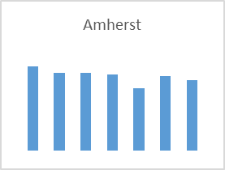
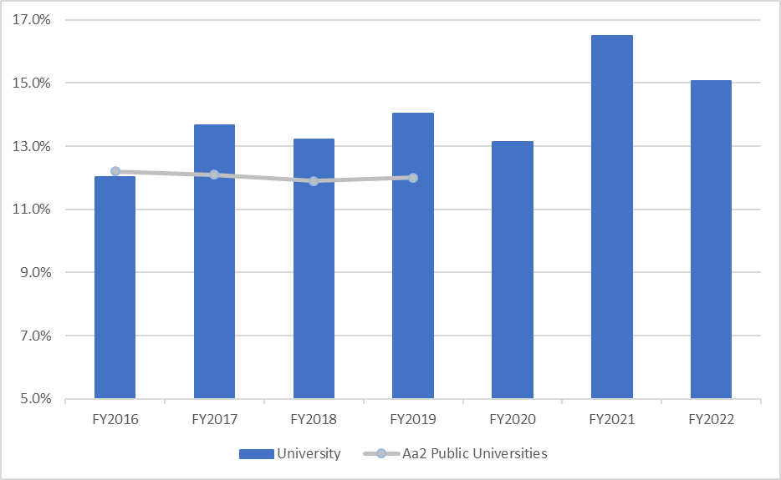
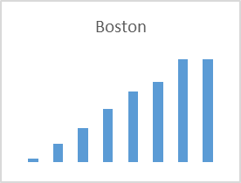
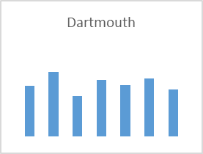
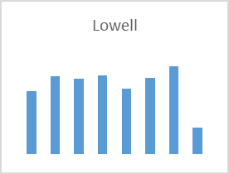
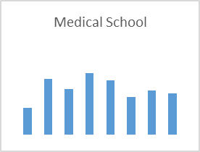
Operating Cash Flow Margin
Excludes impact of GASB 68 & 75

Slide 35
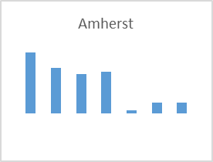
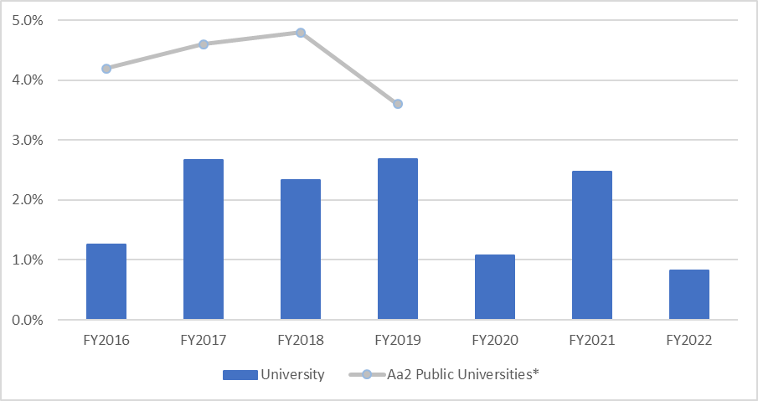
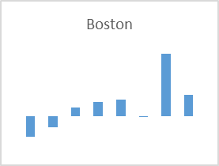
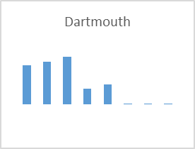
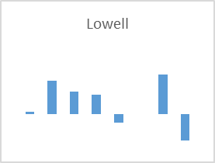
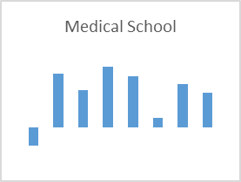
Operating Margin
*Moody’s OM calculation which uses normalized investment income
Excludes impact of GASB 68 & 75

Slide 36
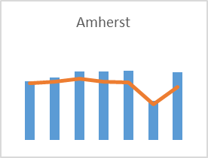
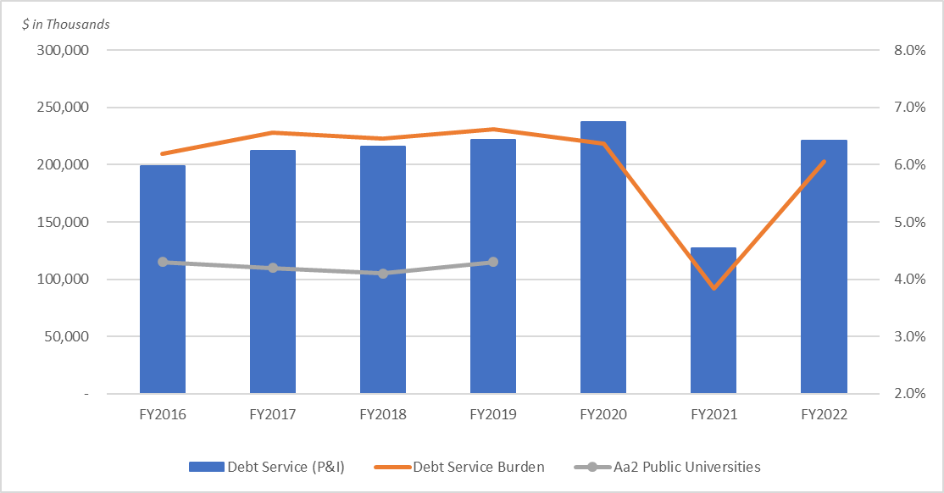
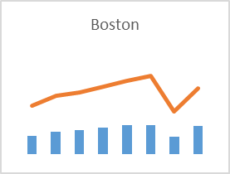
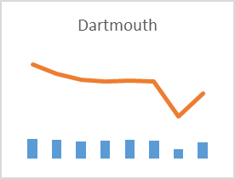
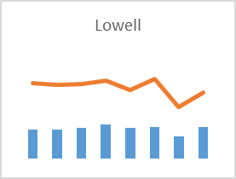
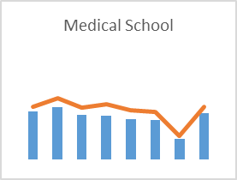
Debt Service Burden
Excludes impact of GASB 68 & 75

Slide 37
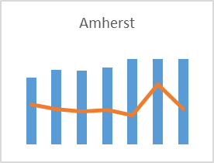
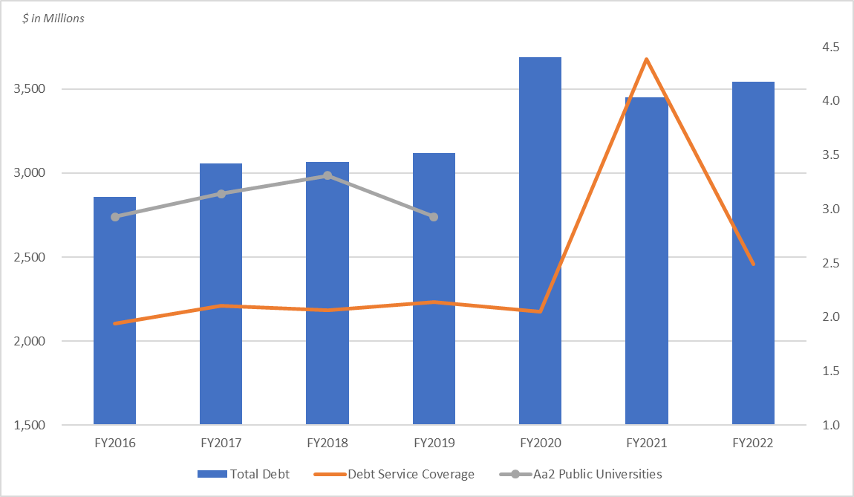
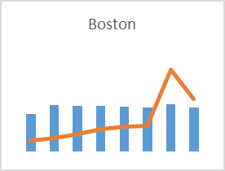
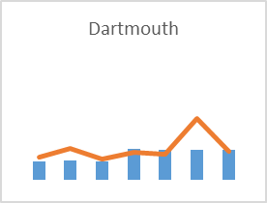
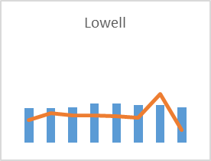
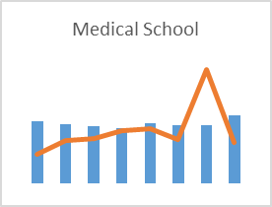
Debt Service Coverage
Excludes impact of GASB 68 & 75;

Slide 38
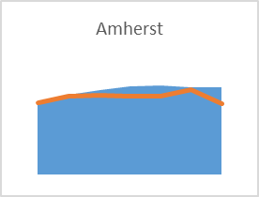
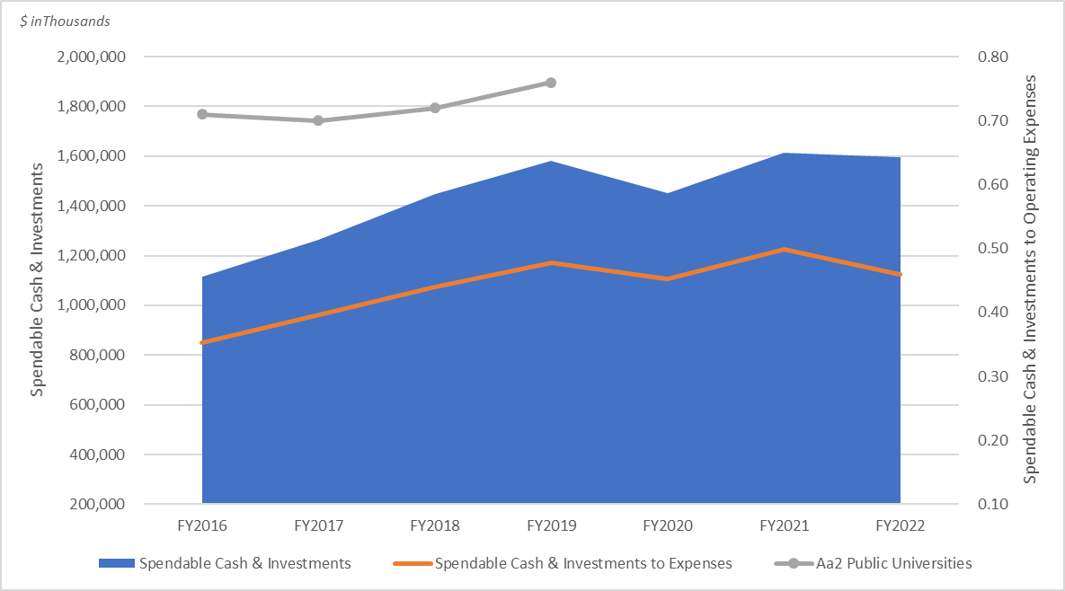
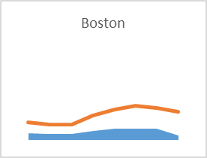
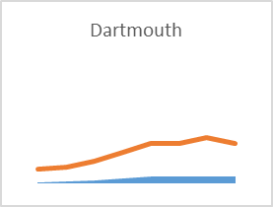
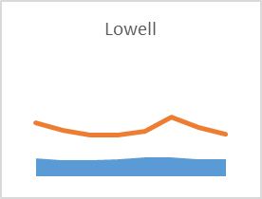
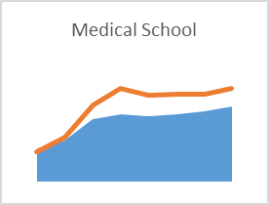
Spendable Cash & Investments
Excludes impact of GASB 68 & 75
Note: Moody’s will be changing it’s rating scorecard and moving to Total Cash & Investments to Operating Expenses

Slide 39
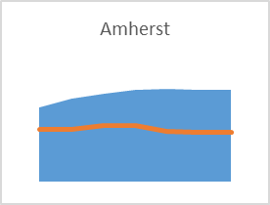
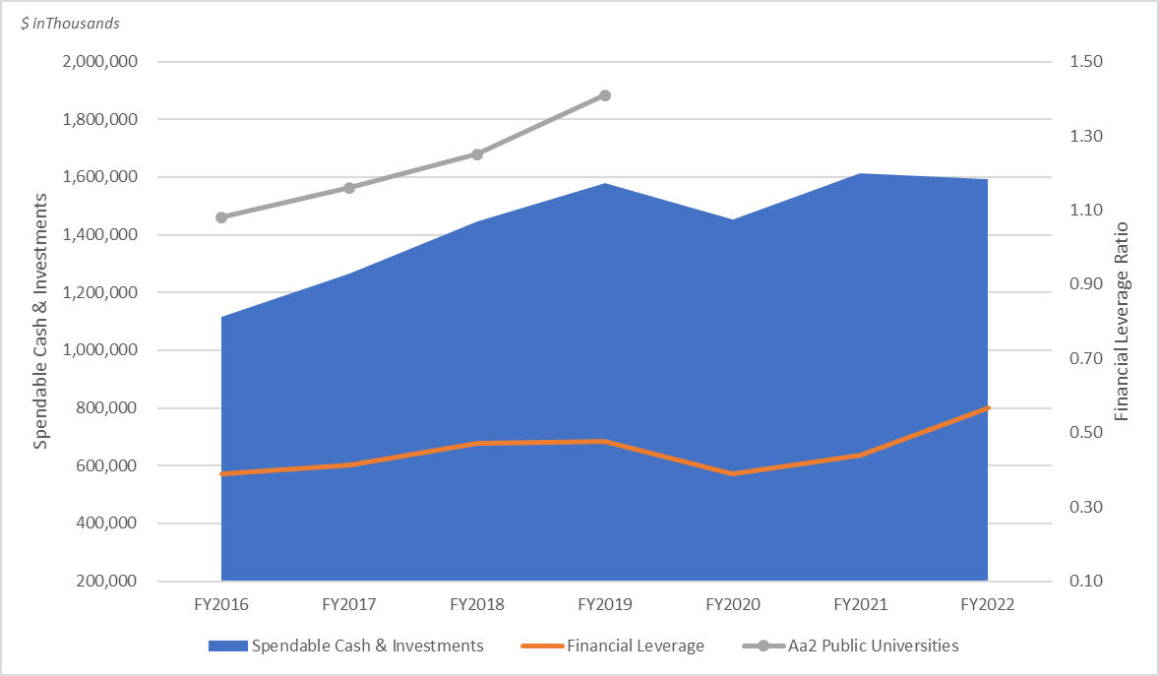
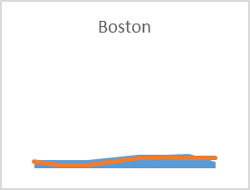
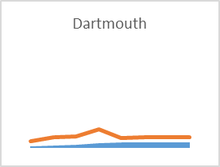
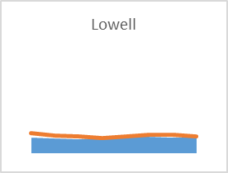
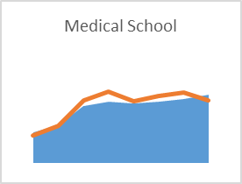
Financial Leverage
Excludes impact of GASB 68 & 75
Note: Moody’s will be changing its rating scorecard and moving to Total Cash & Investments to Total Adjusted Debt

Slide 40
FY22 Revenue & Expenses

Slide 41
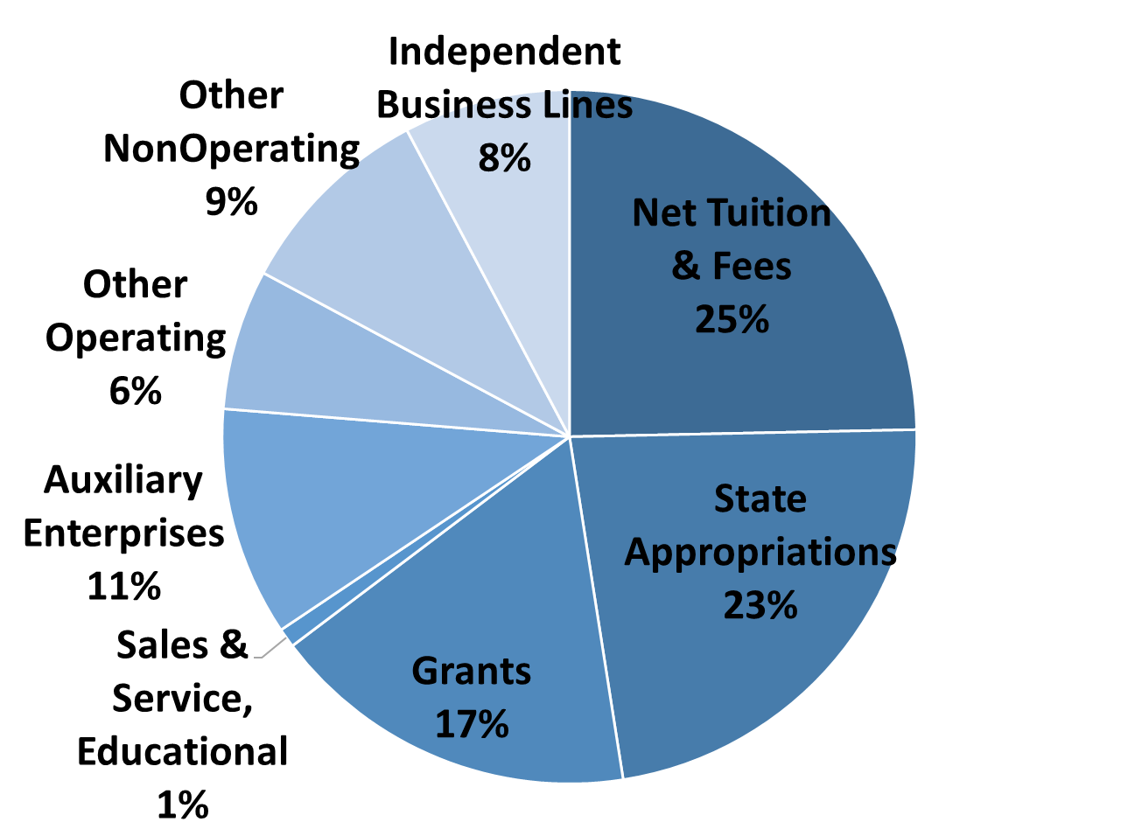
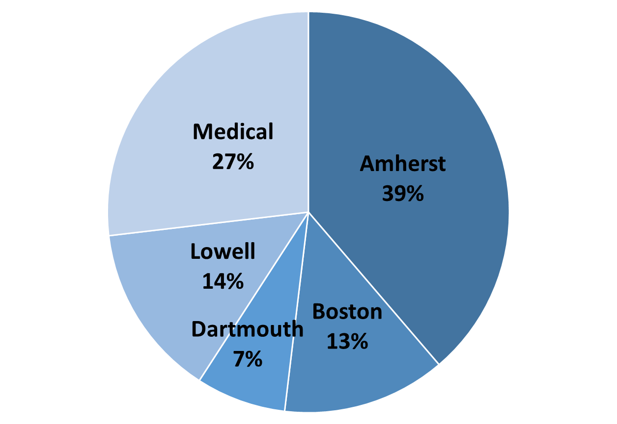
University Revenue = $3.7 billion; an increase of 7.8%
Category
Campus

Slide 42
Student Emergency Aid Grants: by Legislation

Slide 43
Accounting for Institutional Stimulus: by Legislation

Slide 44
University Revenue: by Revenue Category
Note: Total revenue includes unrealized gains/losses that are excluded from the operating margin calculation

Slide 45
Revenue: by Campus
Note: Total revenue includes unrealized gains/losses that are excluded from the operating margin calculation

Slide 46
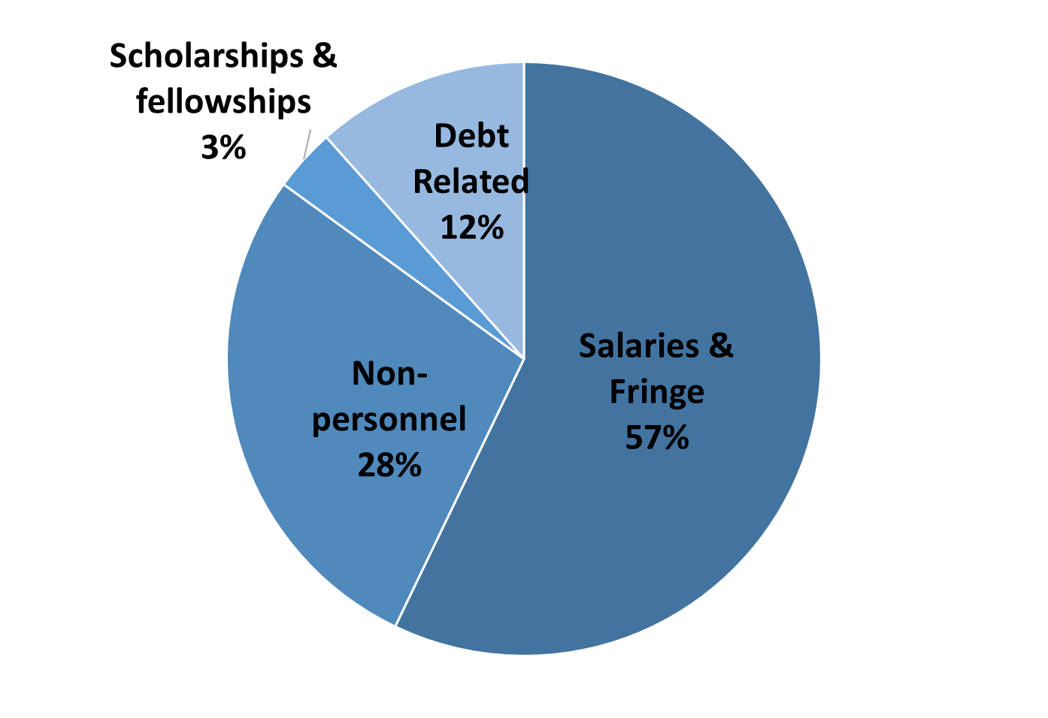
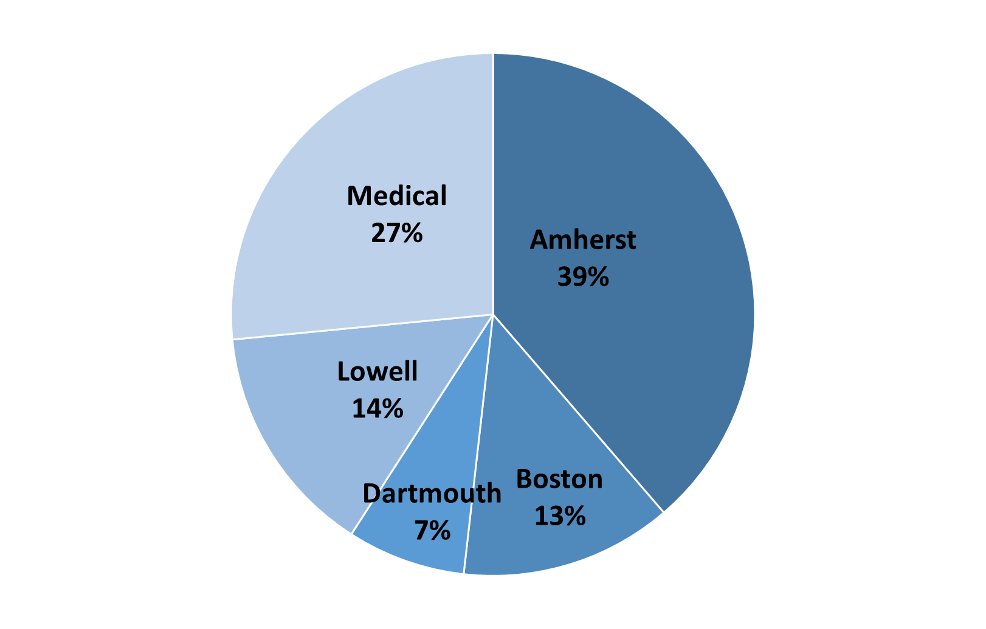
University Expenses = $3.6 billion; an increase of 9.6%
Category
Campus

Slide 47
University Expenses: by Expense Category
Note: Total expenses excludes the impact of GASB 68&75 consistent with the operating margin calculation

Slide 48
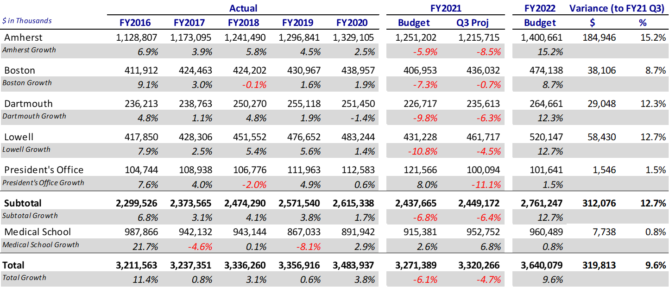
Expenses: by Campus
Note: Total expenses excludes the impact of GASB 68&75 consistent with the operating margin calculation

Slide 49
FY23-27 Preliminary Forecast Trends

Slide 50
FY23-27 Preliminary Forecast: Assumptions & Take Aways
Assumptions:
Revenue: average growth 2.5% annually; 11.8% over forecast
  Tuition & Fees - 2.5% increase
  Enrollment – average growth 0.4% annually; 1.2% over forecast; varies by campus
  Housing occupancy – normal operations
Expenses: average growth 2.5% annually; 11.3% over forecast
  Collective Bargaining - 2%
  Requires expense reductions to achieve balance
Key Take Aways:
Uncertainty continues to exist; using history as a predictor of future performance may not always work
Preliminary assumptions reflect return to steady 2.5% revenue growth; previous forecast closer to 3%
Enrollment relatively flat annually impacted by pandemic and overall demographic shift
Expense reductions will be needed annually to achieve a balanced budget; operating margin growth must be assessed
Refined forecast to be completed for December Board meeting

Slide 51
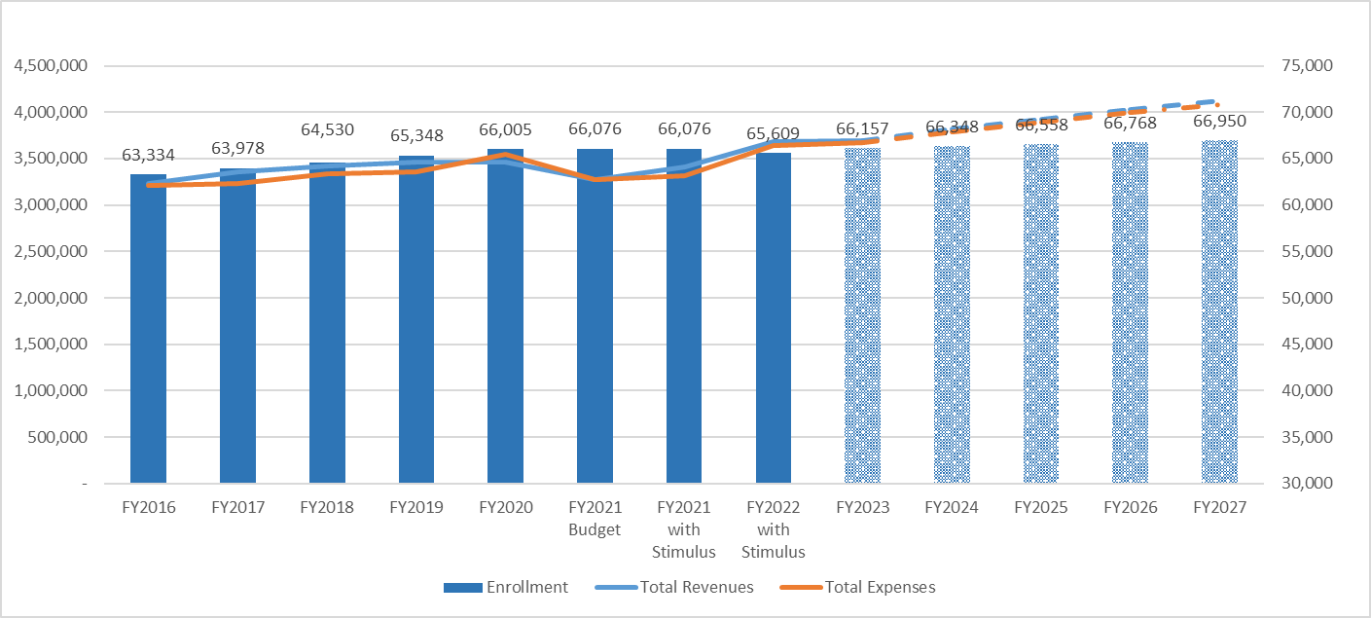
University: Preliminary Forecast

Slide 52
Campus Details

Slide 53
University

Slide 54
University: Revenue & Expenses
Note: Total revenue includes unrealized gains/losses that are excluded from the operating margin calculation; total expenses excludes the impact of GASB 68&75 consistent with the operating margin calculation

Slide 55
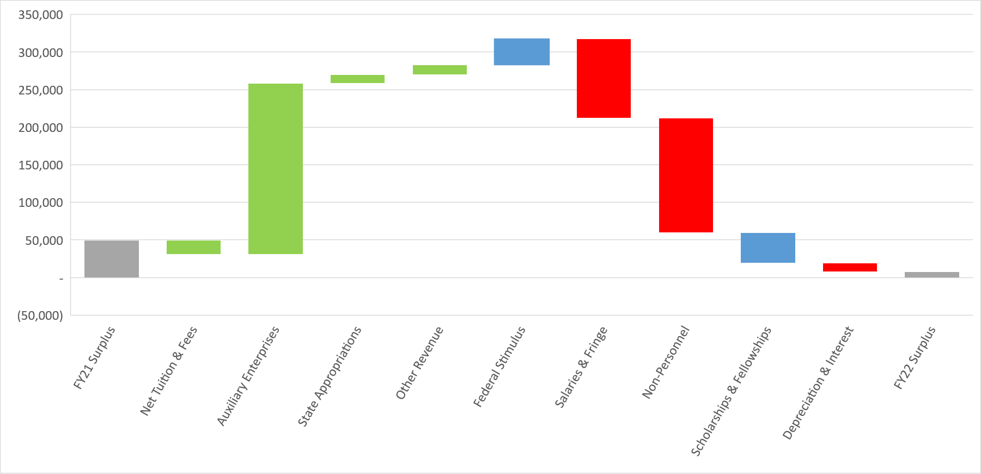
FY22 Undergraduate Revenue & Expense Changes
Revenue increase = $268.0M
Expense increase = $310.5M
$34.8M
$11.6M
$13.2M
$227.7M
$106.1M
$49.9M
$152.0M
$7.4M
-$19.3M
$40.4M
$11.9M
Emergency student aid expenses reflected in scholarships & fellowships; institutional aid expenses including in salaries & fringe and non-personnel

Slide 56
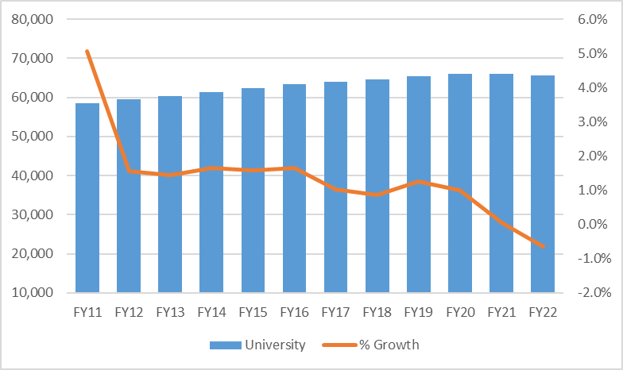
University: Enrollment Trend
Source: Actuals from student profile.

Slide 57
Enrollment by Career
Source: Actuals from student profile.

Slide 58
Enrollment by New vs Continuing
Source: Actuals from student profile.

Slide 59
Enrollment by Residency
Source: Actuals from student profile.

Slide 60
Expense Drivers: Staffing
Note: Historical actuals are as of 9/30

Slide 61
University: Key Ratios
Combined operating margin FY21-22 =
+$114.5M; 1.6%
*Q3 projected debt service reflects restructured FY21 principal resulting in lower total debt service

Slide 62
Amherst

Slide 63
Amherst: Revenue & Expenses
Note: Total revenue includes unrealized gains/losses that are excluded from the operating margin calculation; total expenses excludes the impact of GASB 68&75 consistent with the operating margin calculation

Slide 64
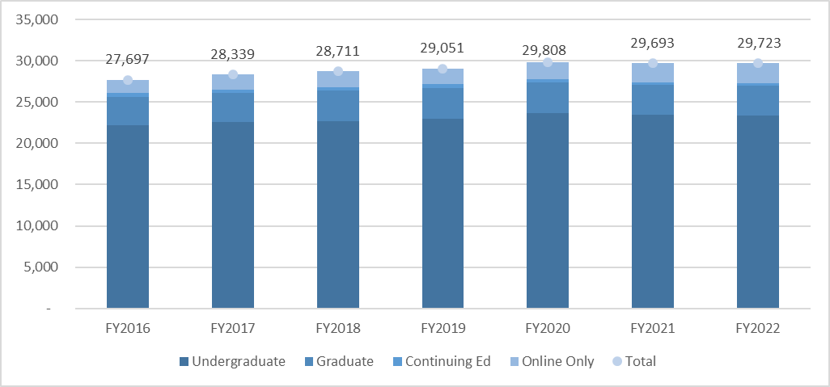
Amherst: Enrollment by Career
Source: Actuals from student profile.

Slide 65
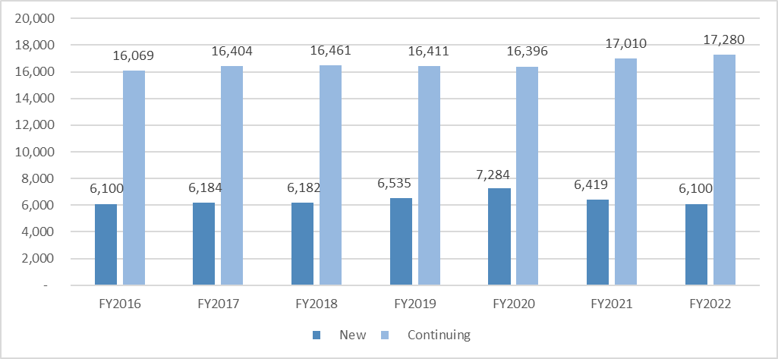
Amherst: Enrollment by New v Continuing
Source: Actuals from student profile.

Slide 66

Amherst: Enrollment by Residency
Source: Actuals from student profile.

Slide 67
Amherst: Staffing & Staffing Ratios
Note: Historical actuals are as of 9/30; FY22 staffing includes return to normal operations specifically in housing and dining and filling of some vacant positions.

Slide 68
Amherst: Key Ratios
Combined operating margin FY21-22 =
$18.3M; 0.7%
*Q3 projected debt service reflects restructured FY21 principal resulting in lower total debt service

Slide 69
Boston

Slide 70
Boston: Revenue & Expenses
Note: Total revenue includes unrealized gains/losses that are excluded from the operating margin calculation; total expenses excludes the impact of GASB 68&75 consistent with the operating margin calculation

Slide 71

Boston: Enrollment by Career
Source: Actuals from student profile.

Slide 72

Boston: Enrollment by New v Continuing
Source: Actuals from student profile.

Slide 73

Boston: Enrollment by Residency
Source: Actuals from student profile.

Slide 74
Boston: Staffing & Staffing Ratios
Note: Historical actuals are as of 9/30; FY22 staffing reflects average staffing as of 9/30 which includes filling some vacant positions.

Slide 75
Boston: Key Ratios
Combined operating margin FY21-22 =
+$35.5M; 3.8%
*Q3 projected debt service reflects restructured FY21 principal resulting in lower total debt service; FY20 Debt Burden excludes Bayside principal pre-payment.

Slide 76
Dartmouth

Slide 77
Dartmouth: Revenue & Expenses
Note: Total revenue includes unrealized gains/losses that are excluded from the operating margin calculation; total expenses excludes the impact of GASB 68&75 consistent with the operating margin calculation

Slide 78

Dartmouth: Enrollment by Career
*Continuing Ed includes Online Only FTEs
Source: Actuals from student profile.

Slide 79

Dartmouth: Enrollment by New v Continuing
Source: Actuals from student profile.

Slide 80

Dartmouth: Enrollment by Residency
Source: Actuals from student profile.

Slide 81
Dartmouth: Staffing & Staffing Ratios
Note: Historical actuals are as of 9/30; FY22 staffing reflects plan to fill vacant positions including 17 faculty, 54 staff and 3 auxiliary

Slide 82
Dartmouth: Key Ratios
Combined operating margin FY21-22 =
$0; 0%
*Q3 projected debt service reflects restructured FY21 principal resulting in lower total debt service

Slide 83
Lowell

Slide 84
Lowell: Revenue & Expenses
Note: Total revenue includes unrealized gains/losses that are excluded from the operating margin calculation; total expenses excludes the impact of GASB 68&75 consistent with the operating margin calculation

Slide 85

Lowell: Enrollment by Career
Source: Actuals from student profile.

Slide 86

Lowell: Enrollment by New v Continuing
Source: Actuals from student profile.

Slide 87

Lowell: Enrollment by Residency
Source: Actuals from student profile.

Slide 88
Lowell: Staffing & Staffing Ratios
Note: Historical actuals are as of 9/30; FY22 staffing includes 178 vacant positions filled; no new positions proposed

Slide 89
Lowell: Key Ratios
Combined operating margin FY21-22 =
+$3.5M; 0.4%
*Q3 projected debt service reflects restructured FY21 principal resulting in lower total debt service

Slide 90
Medical School

Slide 91
Medical: Revenue & Expenses
Note: Total revenue includes unrealized gains/losses that are excluded from the operating margin calculation; total expenses excludes the impact of GASB 68&75 consistent with the operating margin calculation

Slide 92

Medical: Enrollment by Career
Source: Actuals from student profile.

Slide 93

Medical: Enrollment by Residency
Source: Actuals from student profile.

Slide 94
Medical: Staffing & Staffing Ratios
Note: Historical actuals are as of 9/30

Slide 95
Medical: Key Ratios
*Q3 projected debt service reflects restructured FY21 principal resulting in lower total debt service

Slide 96
President’s Office

Slide 97
President’s Office: Revenue & Expenses
Note: Total revenue includes unrealized gains/losses that are excluded from the operating margin calculation; total expenses excludes the impact of GASB 68&75 consistent with the operating margin calculation

Slide 98
President’s Office: Staffing
Note: Historical actuals are as of 9/30; FY22 staffing includes 26.5 vacant positions filled; 12 new positions proposed; UMDI included FY2018 through FY2020

Slide 99
President’s Office: Key Ratios

